Slide 1
Flappy McCaw style guide

Slide 2
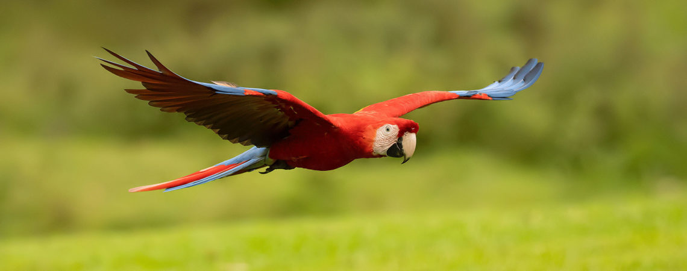
Inspiration for the plus name and bird come from parrots.

Slide 3
Inspiration for the changing theme
The theme changed based on the seasons.

Slide 4

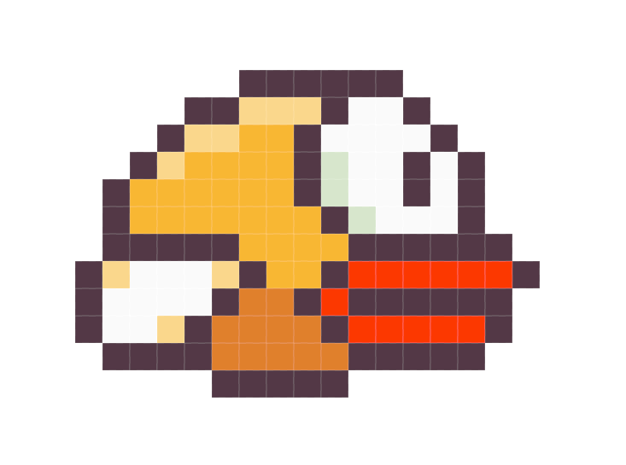
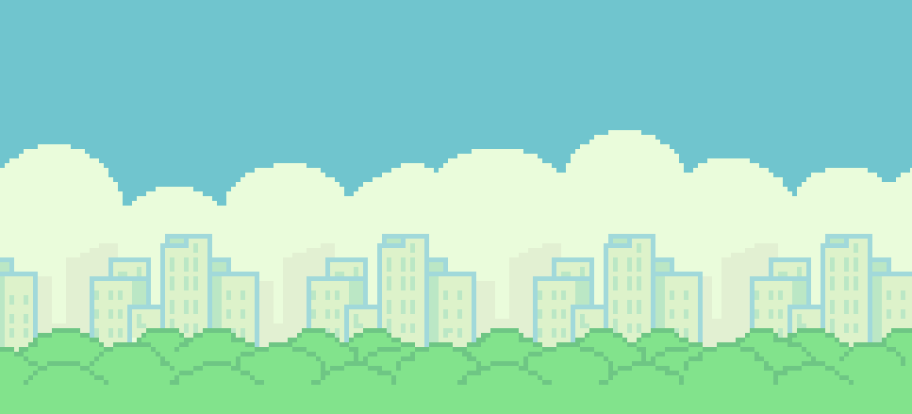
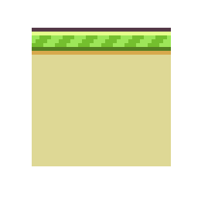
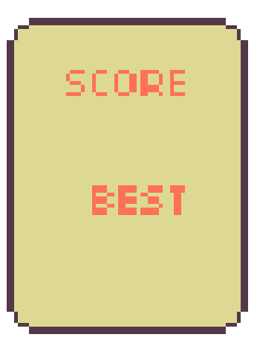
Game Art

Slide 5
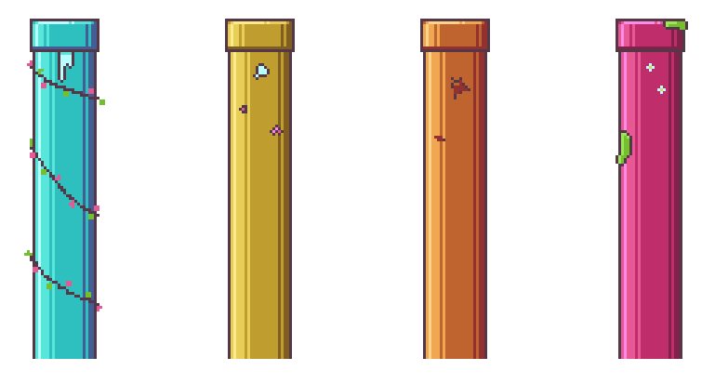
Plus Game Art Assets

